Slide 1
Centralized wPRF (packed)
Files:
PRF.cpp
PackedMod2.hpp
PackedMod2.hpp
methods | No.of times | Cost for each call | Total call
toeplitzByVec | 1 | 25n | 25n
toArray | 1 | 2n | 2n
fromArray | 1 | 8n | 8n
matByVec | 1 | 37n | 37n
Total | 3 |  | ~72n = 18,432

Slide 2
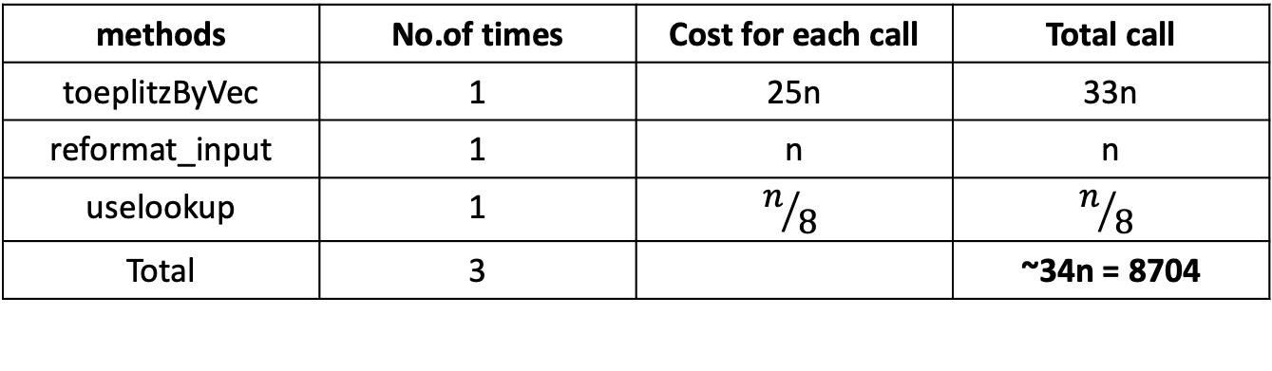
Centralized wPRF (packed + lookup table)
Files:
test_packed_PRF_central_lookup.cpp
lookup_functions.cpp
PackedMod2.hpp
methods | No.of times | Cost for each call | Total call
toeplitzByVec | 1 | 25n | 33n
reformat_input | 1 | n | n
uselookup | 1 | $$n/8$$ | $$n/8$$
Total | 3 |  | ~34n = 8704

Slide 3
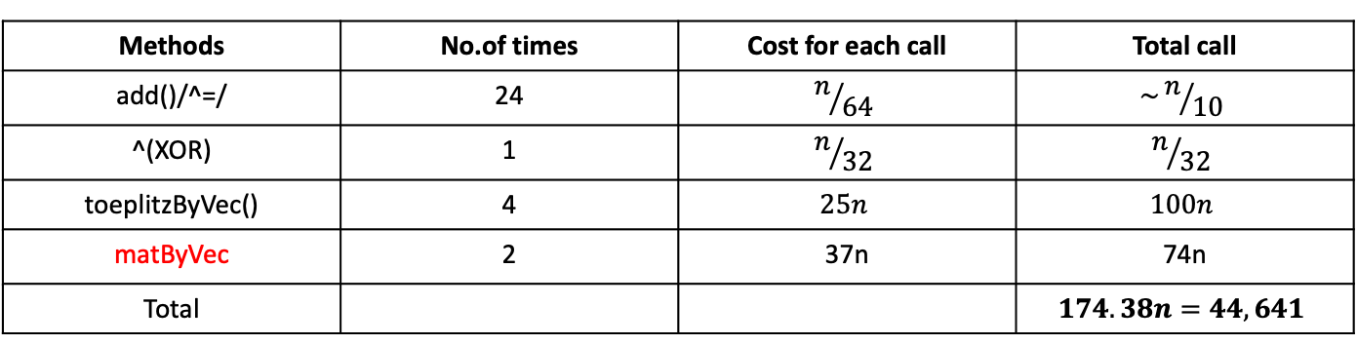
TCC’18 with packed
Files:
PRF.cpp
Toeplitz-by-x.cpp
OT.cpp
PackedMod2.hpp
Methods | No.of times | Cost for each call | Total call
add()/^=/ | 24 | $$n/{64}$$ | $$\sim n/{10}$$
^(XOR) | 1 | $$n/{32}$$ | $$n/{32}$$
toeplitzByVec() | 4 | $$25n$$ | $$100n$$
matByVec | 2 | 37n | 74n
Total |  |  | $$174.38n=44,641$$

Slide 4
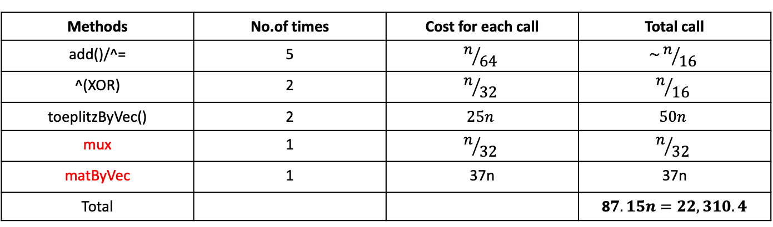
Fully Distributed (packed)
Files:
new_protocol.cpp
PackedMod2.hpp
PackedMod3.hpp
Methods | No.of times | Cost for each call | Total call
add()/^= | 5 | $$n/{64}$$ | $$\sim n/{16}$$
^(XOR) | 2 | $$n/{32}$$ | $$n/{16}$$
toeplitzByVec() | 2 | $$25n$$ | $$50n$$
mux | 1 | $$n/{32}$$ | $$n/{32}$$
matByVec | 1 | 37n | 37n
Total |  |  | 8$7.15n=22,310.4$

Slide 5
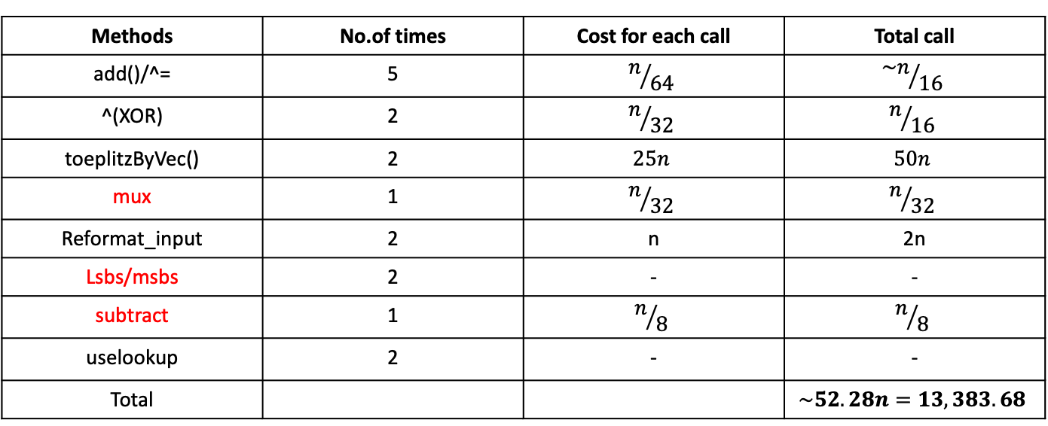
Fully Distributed with (packed + lookup)
Files:
new_protocol.cpp
lookup_functions.cpp
PackedMod2.hpp
PackedMod3.hpp
Methods | No.of times | Cost for each call | Total call
add()/^= | 5 | $$n/{64}$$ | $${\sim n}/{16}$$
^(XOR) | 2 | $$n/{32}$$ | $$n/{16}$$
toeplitzByVec() | 2 | $$25n$$ | $$50n$$
mux | 1 | $$n/{32}$$ | $$n/{32}$$
Reformat_input | 2 | n | 2n
Lsbs/msbs | 2 | - | -
subtract | 1 | $$n/8$$ | $$n/8$$
uselookup | 2 | - | -
Total |  |  | $$\sim 52.28n=13,383.68$$

Slide 6
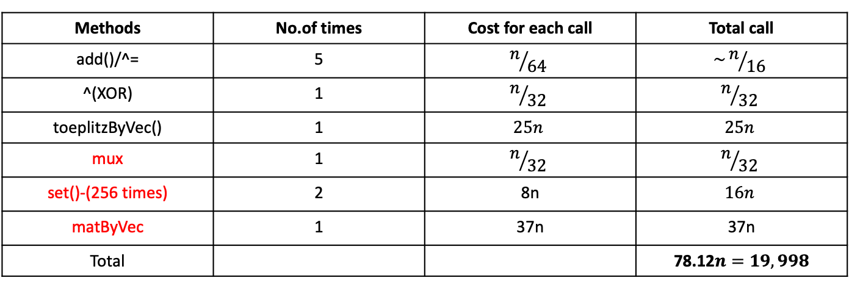
oPRF (packed)
Files:
OPRF.cpp
PackedMod2.hpp
PackedMod3.hpp
Methods | No.of times | Cost for each call | Total call
add()/^= | 5 | $$n/{64}$$ | $$\sim n/{16}$$
^(XOR) | 1 | $$n/{32}$$ | $$n/{32}$$
toeplitzByVec() | 1 | $$25n$$ | $$25n$$
mux | 1 | $$n/{32}$$ | $$n/{32}$$
set()-(256 times) | 2 | 8n | $$16n$$
matByVec | 1 | 37n | 37n
Total |  |  | 78.12$n=19,998$

Slide 7
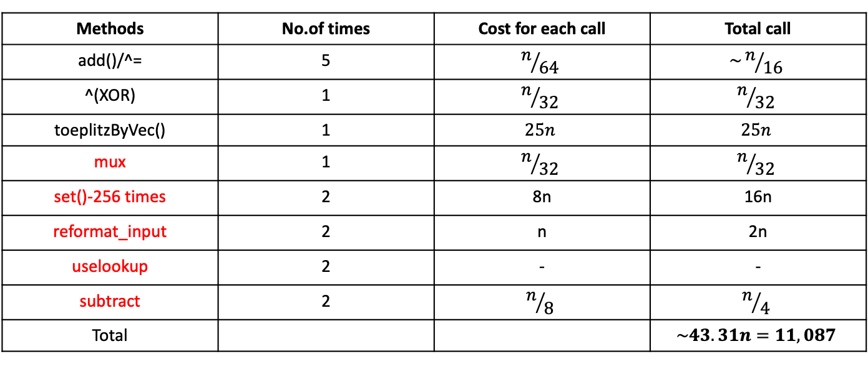
oPRF (packed + lookup)
Files:
OPRF.cpp
lookup_function.cpp
PackedMod2.hpp
PackedMod3.hpp
Methods | No.of times | Cost for each call | Total call
add()/^= | 5 | $$n/{64}$$ | $$\sim n/{16}$$
^(XOR) | 1 | $$n/{32}$$ | $$n/{32}$$
toeplitzByVec() | 1 | $$25n$$ | $$25n$$
mux | 1 | $$n/{32}$$ | $$n/{32}$$
set()-256 times | 2 | 8n | 16n
reformat_input | 2 | n | 2n
uselookup | 2 | - | -
subtract | 2 | $$n/8$$ | $$n/4$$
Total |  |  | $$\sim 43.31n=11,087$$

Slide 8

DIDO(Fully Distributed with packed)
party1_round_1: 9 operations
Party2_round_1: same
Both K, $Rk_{1}$ are Toeplitz

